Slide 1

DSLab
The Data Science Lab
Stream Processing
Spring 2020 – week #9

Slide 2
Stream Processing Module
Objectives
Review concepts of stream processing
Experiment with typical tools for
Data ingestion and processing
Week 9
Concepts
Experiments
Week 10
Advanced topics
Operations on streaming data (joins)
Time constraints
Homework

Slide 3
Why Stream Processing?
Reminder from module 2 (Big Data)
Batch vs Stream
Can wait until all information is available for a more accurate answer? batch
AKA: Data at rest
Operates on finite size data sets, and terminate when all data has been processed
You want an updated answer as more information becomes available? streams
AKA: Data in motion, or Fast data
Continuous computation that never stop, process infinite amount of data on the fly
Designed to keep size of in-memory state bounded, regardless of how much data is processed
Update the answer as more data becomes available
Operate on small time windows

Slide 4
Why Stream Processing?
Relevance (vs batch)
Insight more valuable shortly after events happen
(Near) real-time: from milliseconds to seconds, or minutes
It allows faster reaction
Detecting patterns, setting alerts
Some data is naturally unbounded (e.g. sensor data)
Resource constraints (storage and compute)
process large large volumes of data arriving at high velocities
Retain only what is useful
Continuous processing

Slide 5
Applications of Stream Processing
Computing
Log analysis,
Detection of DoS attacks,
Scaling service capacities
Real-time monitoring
Fraud detection (credit cards),
Intrusion detection (surveillance)
Sensor data processing
Weather,
Transportation
Traffic
Patient health
Social media
Trend analysis
Industry
Process optimization
Predictive maintenance
Logistics
Advertising and promotions
Contextualized to user behavior or geolocation
Financial trading
Algorithmic trading
Risk analysis
…

Slide 6
Constraints and challenges
Inputs
Time constraints
Data elements
Unbound
Unordered
Uncomplete
Outputs
Approximate answers

Slide 7
Sliding Window
Time flow
Sliding window

Slide 8
Related Concepts
Event Time vs Processing Time
Types of Windows
Sliding
Tambling
Time-based vs count-based
Window Operations (transformations)
Stateful / Stateless Operations (transormations)

Slide 9
Related Concepts
Event Time
Processing Time
lag

Slide 10
Related Concepts
Sliding Windows
Events
Tumbling windows
Events

Slide 11
Related Concepts
Time-based windows
Events
t = 10:00
t = 10:05
t = 10:10
Count-based windows
Events

Slide 12
Related Concepts
Window Operations (transformations)
Aggregations
Sums, averages, counts, maximum, …
Filtering
By type, IDs, …
…

Slide 13
Related Concepts
Stateful vs Stateless Operations (Transformations)
Stateful: need to memorize records or partial results
e.g. Min, Max and average temperature of a sensor
Stateless: rely only on information within the window
e.g. Average temperature of sensor over last 5 minutes

Slide 14



Stream Processing - Tools

Slide 15
Stream Processing - Tools

Slide 16

Stream Processing - Tools

Slide 17
Kafka
Messaging system
Publish & Subscribe
Distributed
Fault tolerant
Scalable (large data volumes)
Real-time
Low latency

Slide 18
Kafka
Concept of Publish/Subscribe messaging
Publisher 1
Subscriber 1
Topic A
Publisher 2
Icons made by Freepik from www.flaticon.com
Subscriber 2
Publisher 3
Topic B
Publisher 4
Subscriber 3

Slide 19
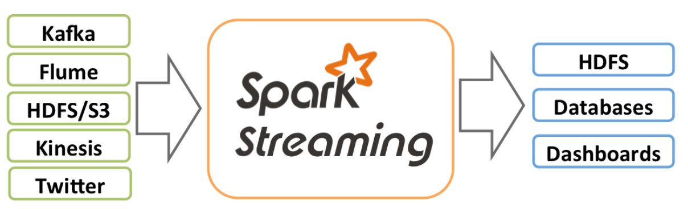
Spark Streaming
Extension to Spark
Integrated with Spark API
Scalable, fault tolerant
Can read from multiple sources
Apply ML algorithms to data streams
Image credits: https://spark.apache.org/docs/latest/streaming-programming-guide.html

Slide 20
Spark Streaming
Batch
Stream
How it works
Micro-batches processing
DStream: continuous stream of data
Created from inputs (e.g. Kafka) or derived from other Dstreams
Continuous series of RDDs
Supports (many) transformations similar to RDDs
(map, count, join, etc)
Micro-batch
Image credits: https://spark.apache.org/docs/latest/streaming-programming-guide.html

Slide 21
Exercise
Documentation and Resources
Spark Streaming Programming Guide [1]
Kafka Documentation [2]
Practical Exercise
See course website: https://epfl-dslab2020.github.io/ (week9)
[1] https://spark.apache.org/docs/latest/streaming-programming-guide.html
[2] https://kafka.apache.org/documentation/

Slide 22
Exercise
1. Message queue
Introduction to Apache Kafka
Topics
Creation
Publish
Subscribe
Synthetic example

Slide 23
Exercise
2. Stream Processing with Spark Streaming and Kafka
How to properly setup Spark Streaming
Resume synthetic exercise
Connect to Kafka and consume stream
Window operations
Use real public stream

